Slide 1







Hackimon – Our team member
Hi! I am Krystal. I am Global Portfolio Manager in RBWM
Hi! I am KK. I am Infrastructure Lead in Group Function.
Hi! I am Michael working as Senior Lead Solution Architect for GLCM and Payment System in ASP.
Hi! I am Catherine. I am working in GLTCM for BI projects.
Hi! I am Nick,. I am Business Analyst working in data visualization projects.
Hi! I am April. I am Development Manager working in Qlik Sense projects.
Why we join?
Hackademy is a good learning program.
We have passion to enjoy the latest IT trend and explore the power of AI, Cloud and IoT to change the world

Slide 2
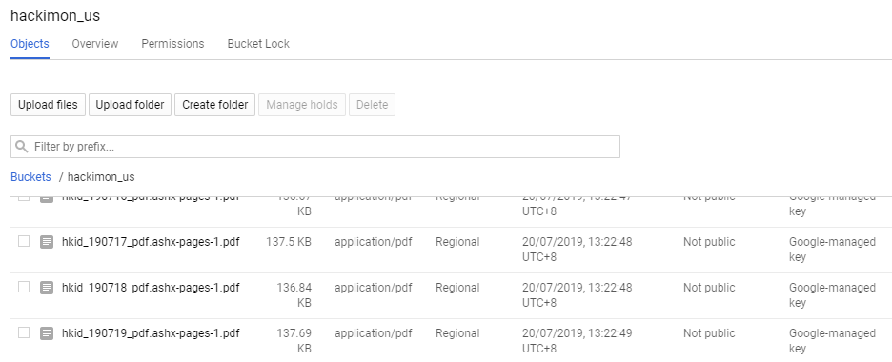
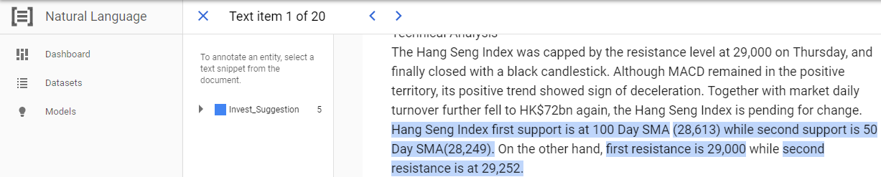
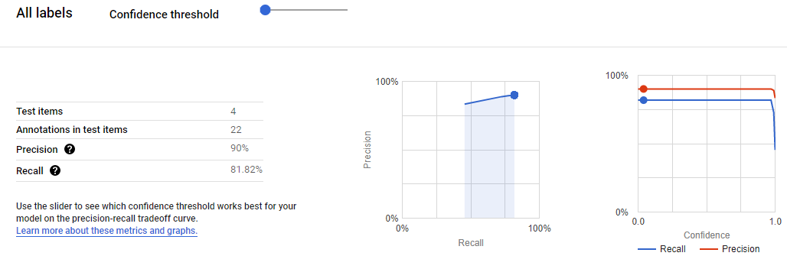
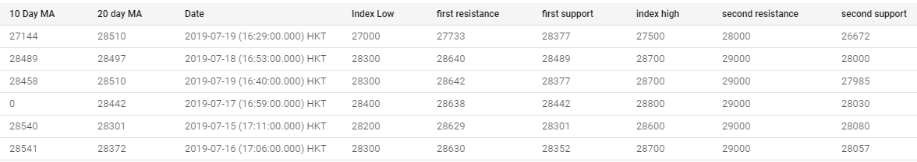
Hackimon – Machine learning
Research Reports delivered to google cloud storage and extract text to a format that fit to Google Auto ML Entity Extraction by using Python/Vision API
Annotate the entities in Auto ML Entity Extraction. The more annotation we provided, the more precise the model will be.
The model was trained/evaluated in Auto ML Entity Extraction. Fine tuning the model by checking the precision and recall.
The data was extracted to Google datastore and ready for chatbox’s queries.

Slide 3






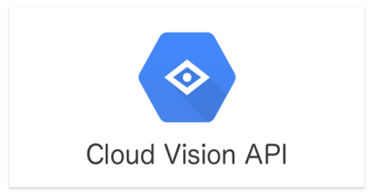





Architecture Logical Diagram
Research daily Financial report
Chatbot
Text / Voice
8. Request
Financial advice
12. Response today financial predictions
1. Upload PDF via API
Cloud Storage
10 Store / Retrieve
Prediction
Cloud Datastore
2. Trigger Cloud function
9. Run
Application
(Python)
5. Labelled Data (Stock related entities)
6. Supervised training data
3. Extract Text and convert format (using Python)
Cloud Machine learning
4. load formatted data
7. AutoML Natural Language Entity Extraction
Trained Model
Cloud Storage
Cloud AutoML

